Slide 1
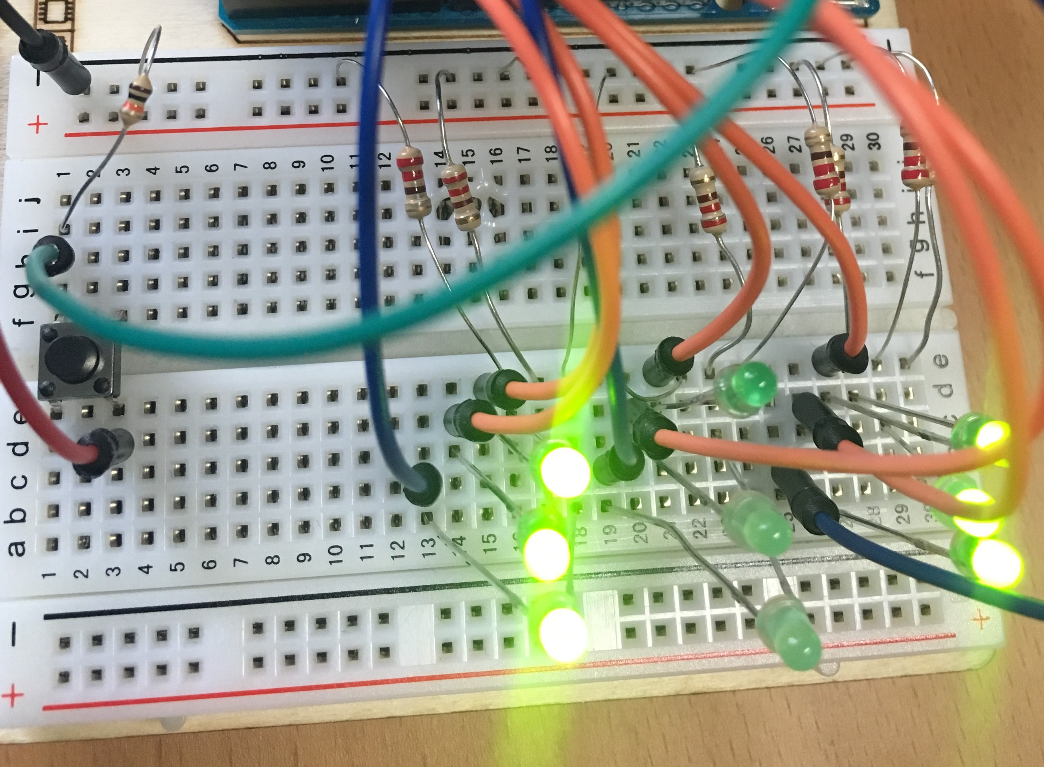
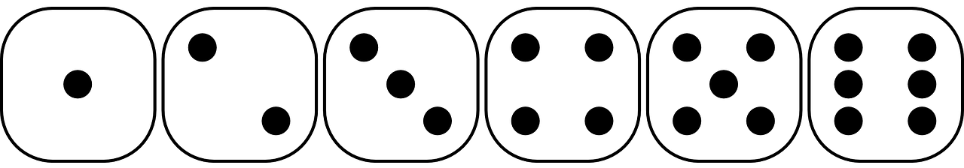
Die Assignment Overview

Slide 2

Die Roll LED State (On/Off)

Slide 3

Die Roll LED State (On/Off)

Slide 4
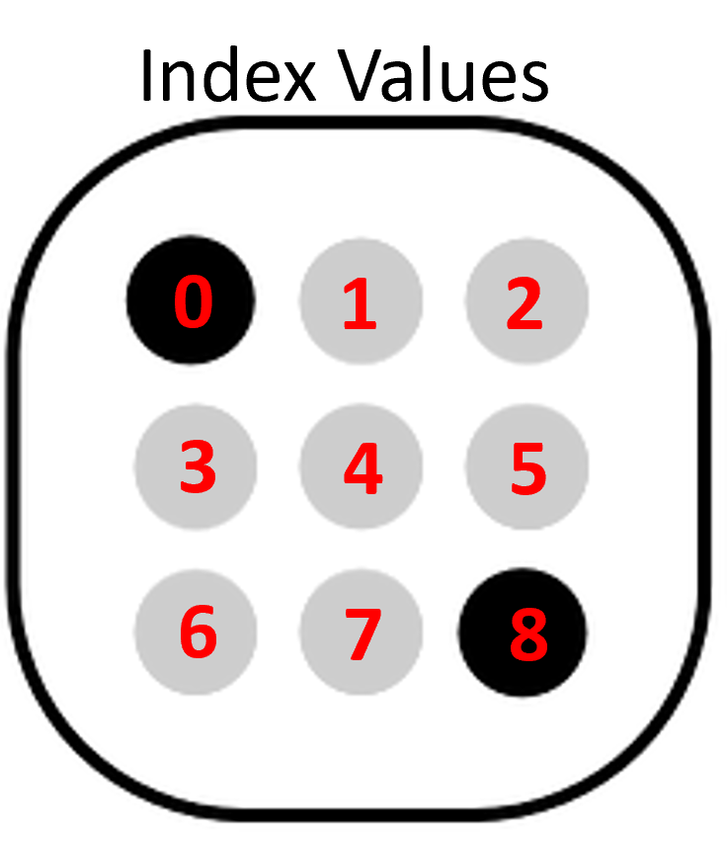
Die Roll LED State (On/Off)

Slide 5
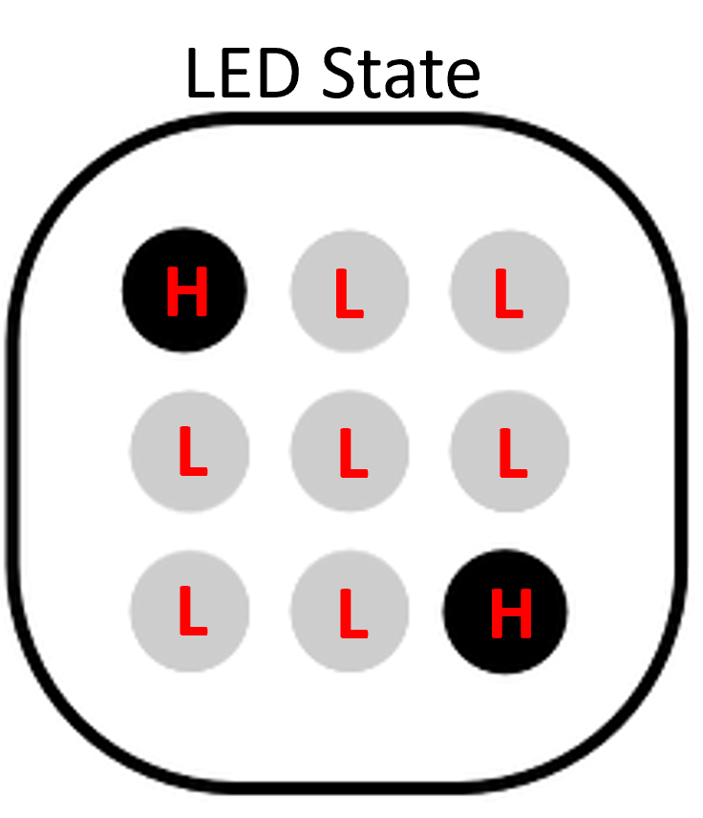
Die Roll LED State (On/Off)

Slide 6
"Unwrapping" an Array

Slide 7
Controlling Individual LEDs

